Slide 1
Experimental Research Strategy

Slide 2
Example: Diffusion of Responsibility (Darly & Latané, 1968)
More witnesses at an accident/crime, less likely anyone is to help the victim (diffusion of responsibility).
Similar to case of Kitty Genovese
Researchers tested this claim.
Subjects isolated in a room and would discuss university life with other students through an intercom system.
A confederate would have a fake seizure and cry out for help
Only difference was group size
Results: 85% (just victim), 62% (two people), 31% (five people) likelihood of getting help.

Slide 3
Experiments
Experiment – A type of study designed to answer specifically the question of whether there is a causal relationship between two variables.
Whether changes in an independent variable causes a change in a dependent variable.
Goal of experimental research strategy is to establish the existence of a cause-and-effect relationship between two variables.
Independent variable
The variable the experimenter manipulates (cause)
Dependent variable
The variable the experimenter measures (effect).
Effects are always on the dependent variable from manipulating an independent variable……. That doesn’t mean there always has to be an effect.

Slide 4
Examples:
A researcher wants to study the effects of taking paper or electronic notes on test performance. Some students are only allowed to take pen and paper notes, and some students are only allowed to take electronic notes on their laptop. Then the researcher measures the difference in test scores between the two groups.
Independent variable: Type of note taking
Levels of IV: 2 levels (paper, electronic)
Dependent variable: Test score performance

Slide 5
Examples:
A researcher wants to measure the efficiency of sleep in adolescents. They hypothesized that calm, soothing noises would help sleep quality. So they had kids either sleep with a radio playing over night or sleep in silence. The results from this experiment was that kids who had the radio playing woke up fewer times throughout the night compared to the kids who slept in silence.
Independent variable: Presence of auditory sleep aids
Levels of IV: 2 levels (sleep aid/no sleep aid)
Dependent variable: Number of times kids wake up during the night

Slide 6
True vs. quasi experiments
True manipulation = active intervention
You create the groups, and you place people in those separate groups.
Comparing groups of people who already differ on a dimension is NOT the same thing as manipulating a variable.
Handedness as an IV – not true manipulation

Slide 7
Controlling for extraneous factors
Worker productivity. VS.
“ “ “ “
In the light condition, there’s a noise that’s present from the light, and in the no light condition, that noise isn’t there.
Is the worker productivity due to the light condition, or because of this other variable of noise that wasn’t controlled for?
Confounding variable – an extraneous variable (variable other than the IV or DV) that systematically varies along with the variables under investigation and therefore provides an alternative explanation for the results.
Extraneous variable – could affect your DV, but does not systematically change across conditions.

Slide 8
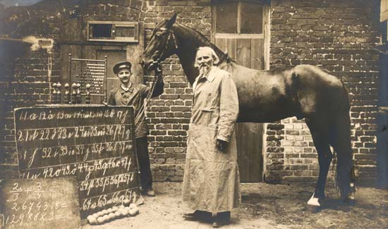
The Case of Clever Hans
“This thinking horse is going to give men of science a great deal to think about for a long time to come” (Fernald, 1984).
The mathematical horse.
Could solve addition/ subtraction/ multiplication problems.
How?

Slide 9
Review: 4 Elements of Experiments
Manipulate one variable to create 2 different conditions
Condition A
Condition B
Measure a second variable to obtain scores in each condition
Scores in A
Scores in B
Compare scores from Condition A and B
P.S. Strive for parsimony!
Keep design as simple as possible while still trying to explain as much as possible.

Slide 10

Final Note: Statistical Significance
Differences in groups could be due to chance.
Need to statistically test differences to rule out chance as a possible explanation!
Differences between left-and right side in movie theater. Due to chance??

